Slide 1
DSP Lab. Week 4 My Audio
Kyuheon Kim
Media Lab. Rm567
leeih10@khu.ac.kr
Last update : September 2, 2019

Slide 2
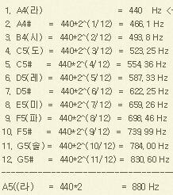
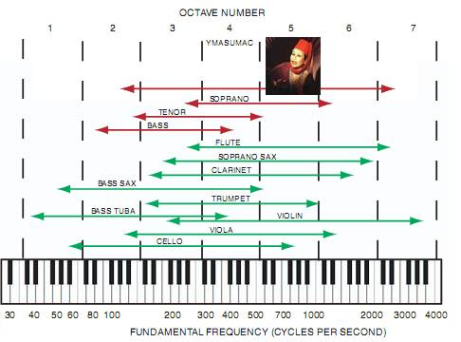
Frequency

Slide 3
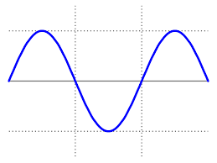
ADC (Analog-to-Digital Conversion)
ADC = sampling + quantization
Sampling = continuous to discrete, 2f_{m}<f_{s}
Quantization = analog to digital, 2^{B} levels
Range (ex) 3분짜리 노래는 몇 바이트?
8bits
255
0
unsigned char
16bits
32768
-32767
short
1/f_{s}
time

Slide 4
Quantization
To efficiently represent the source output, we have to reduce the number of distinct values to a much smaller set.
Uniform scalar quantization
Non-uniform scalar quantization
Vector quantizatoin

Slide 5
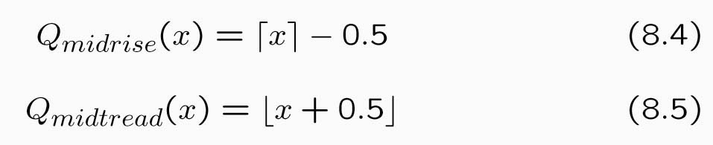
Uniform scalar quantization
A uniform scalar quantizer partitions the domain of input values into equally spaced intervals, except possibly at the two outer intervals.
The endpoints of partition intervals are called the quantizer's decision boundaries.
The output or reconstruction value corresponding to each interval is taken to be the midpoint of the interval.
The length of each interval is referred to as the step size, denoted by the symbol ∆.
Uniform scalar quantizers are of two types: midrise and midtread
In case of ∆=1,

Slide 6
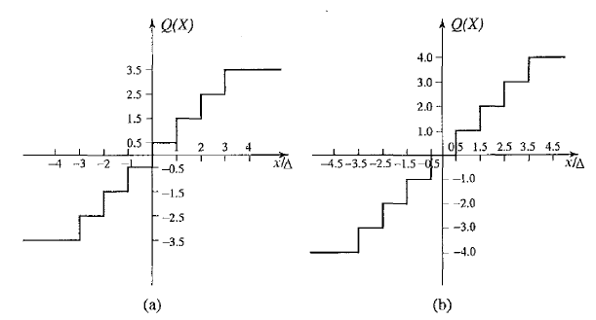

Slide 7
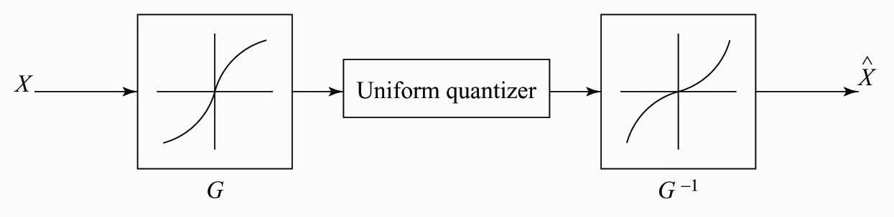
Companded quantizer
the input is mapped by a compressor function G and then quantized using a uniform quantizer.
After transmission, the quantized values are mapped back using an expanded function G⁻¹.

Slide 8

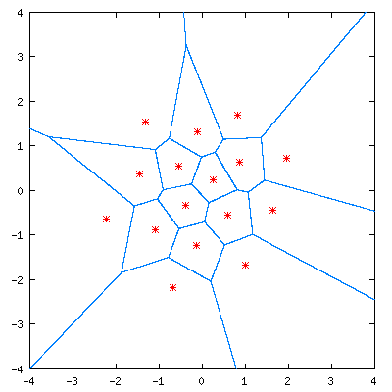
Vector quantization
Any compression system performs better if it operates on vectors or groups of samples rather than on individual symbols or samples.
n-component code vector represents vectors that lie within a region in n-dimensional space.
A collection of these code vectors forms the codebook for the vector quantizer.

Slide 9
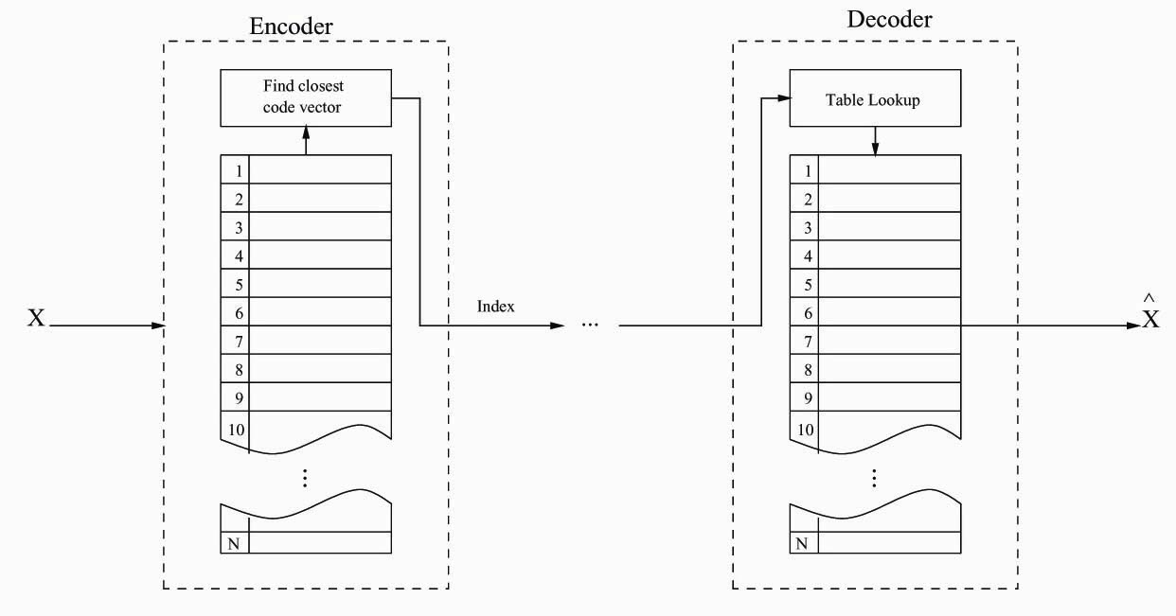

Slide 10
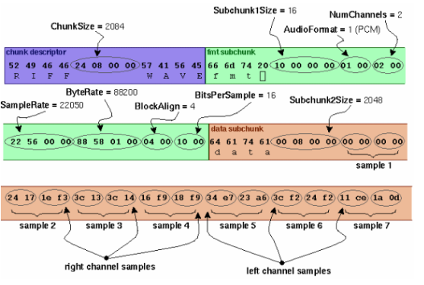
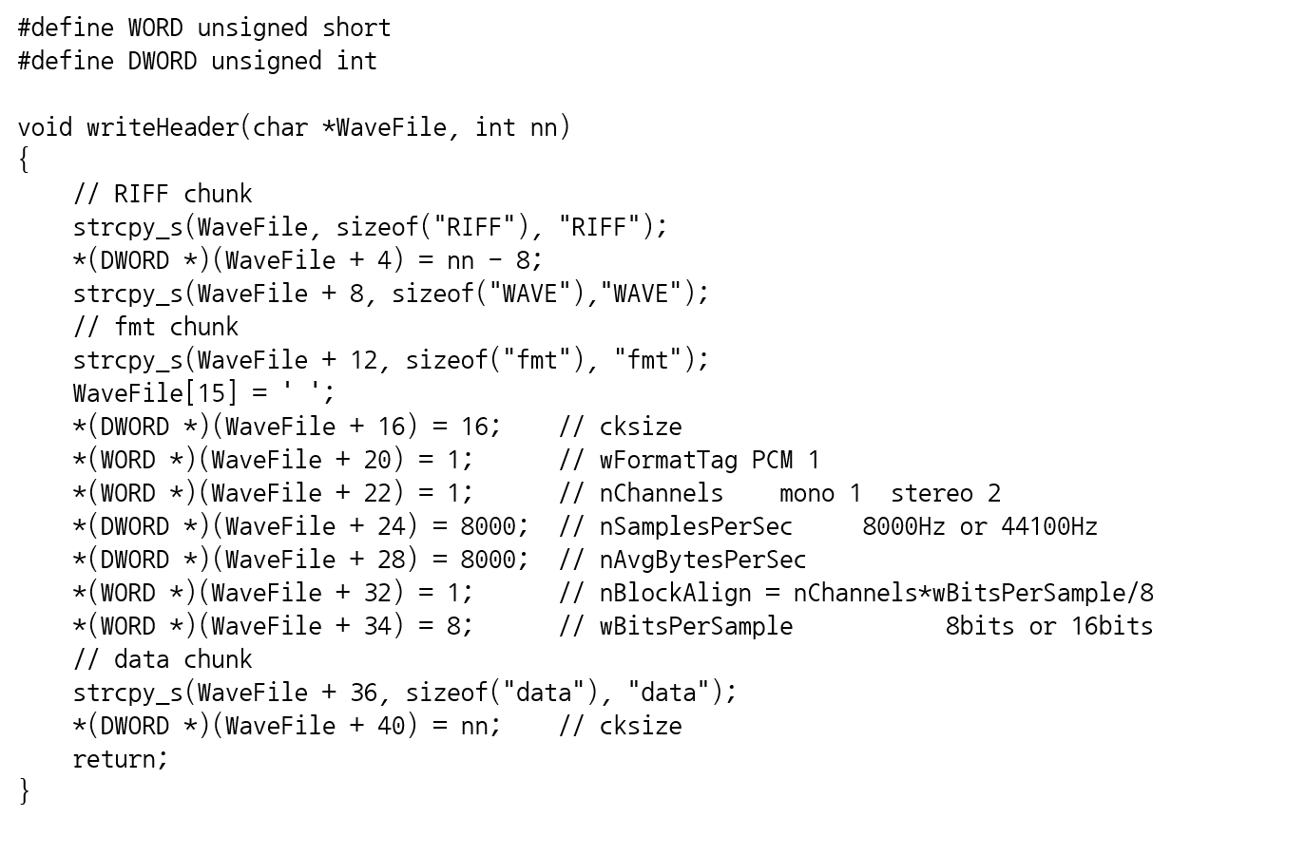
Wave File Header (44 bytes long)

Slide 11
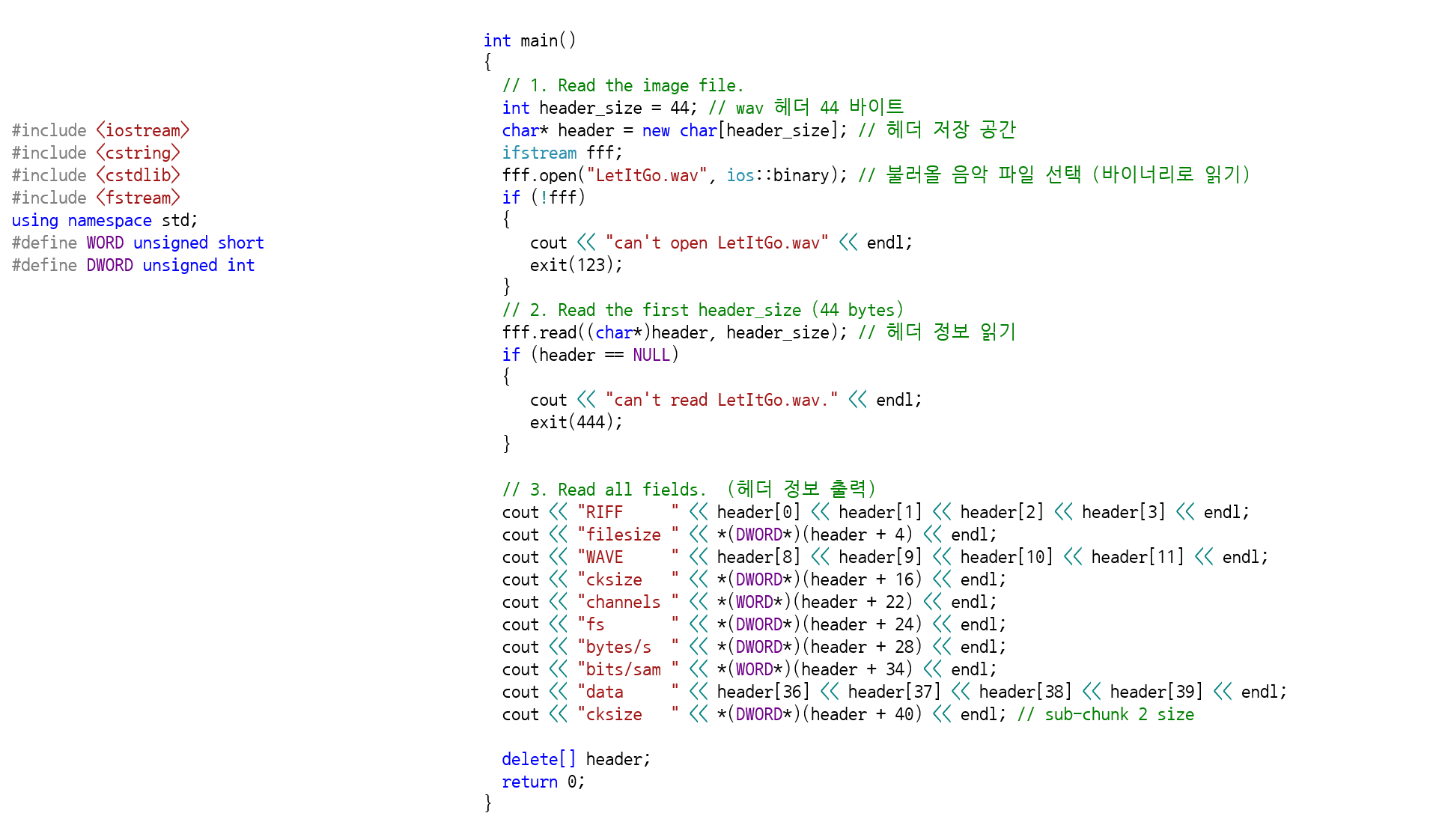
Read header of a wave file

Slide 12
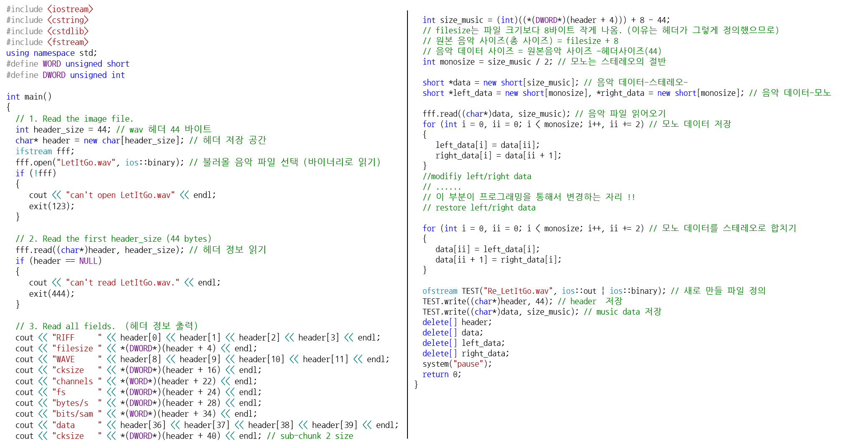

Slide 13
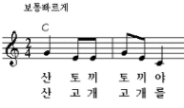
Week 4 assignment
Let It Go 음악 사이에 산토끼를 넣어라.
(ex) 첫 ‘솔’은 0.5초, f_{s}=44100이면, f_{max}=22050
dt = 1/44100.0;
for(t=0; t<0.5; t+=dt)
{
*(leftdata++) = *(rightdata++) = (short)(20000.0*sin(2*PI*784*t));
}

Slide 14
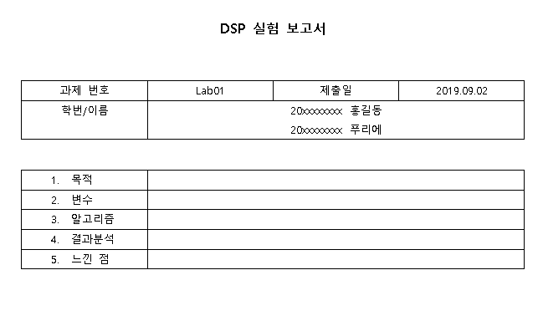

Week 4 assignment
“KLAS에 제출할 때 다음 사항을 꼭 지켜주세요”
파일명 : “Lab00_요일_대표자이름.zip”
Ex) Lab01_목_홍길동.zip (압축 툴은 자유롭게 사용)
2. 제출 파일 (보고서와 프로그램을 압축해서 제출)
- 보고서 파일 (hwp, word): 이름, 학번, 목적, 변수, 알고리즘(순서), 결과 분석, 느낀 점
- 프로그램
C++ 프로그램 파일
보고서
압축하여 제출

